Slide 1
UNVEILING STATISTICAL BIAS IN MACHINE READING COMPREHENSION MODELS THROUGH ADVERSARIAL ATTACKS
Individual Task - 1 Group - 5 Submitted By - Shouri Saha 20101349
Section - 1
Submitted To - Annajiat Alim Rasel
RA: Mehnaz & Sabbir

Slide 2
INTRODUCTION MOTIVATION/PURPOSE CONTRIBUTION METHODOLOGIES AND EXPERIMENTS RESULT LIMITATIONS
FUTURE WORK CONCLUSION

Slide 3
INTRODUCTION
Analysis of machine reading comprehension (MRC) models' statistical bias. The authors propose utilizing adversarial assaults to evaluate MRC model statistical biases. They discover that existing MRC models have severe statistical biases and deteriorate considerably under adversarial assaults. The authors also offer an improved training strategy to eliminate MRC model statistical biases.

Slide 4

MOTIVATION
Identifying Statistical Bias in Machine Reading Comprehension (MRC) Models.
Leveraging Adversarial Attacks for Bias Detection. Enhancing MRC Model Robustness.
Promoting Fairness and Accuracy in MRC Applications

Slide 5
Contribution
A new adversarial attack strategy to discover MRC model statistical biases. The article assesses statistical biases' effect on MRC model performance. Proposed additional training to eliminate MRC model statistical biases.
The study explains MRC model behavior under adversarial assaults.
Promotes fairness in MRC applications.

Slide 6

METHODOLOGY
From RACE dataset, extract questions and answers.
Create adversarial attack
dataset by adding irrelevant phrases.
Evaluate MRC models on adversarial attack dataset. Propose augmented training to mitigate statistical biases. Assess augmented training by training MRC models.

Slide 7

Dataset
The paper "Using Adversarial Attacks to Reveal the Statistical Bias in Machine Reading Comprehension Models" makes use of the RACE dataset, a compilation of multiple-choice reading comprehension questions of exceptional quality. This dataset is intended to challenge the performance of cutting-edge MRC models and is utilized as a standard against which MRC model performance is measured. One thousand test questions, 1,084 development questions, and 108,415 training questions comprise the RACE dataset. Each inquiry is complemented by a corresponding passage and four possible responses, of which only one is deemed accurate.

Slide 8
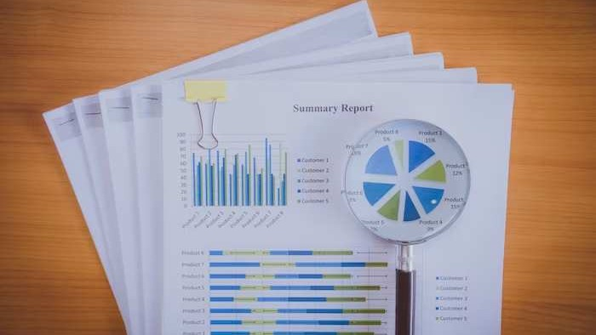
Results Analysis
Detection of Statistical Biases in MRC Models.
Quantiﬁcation of Bias Impact. Mitigation of Statistical Biases. Insights into MRC Model Behavior.
Advancement of Fairness in MRC Applications

Slide 9

CHALLENGES AND LIMITATIONS
Adversarial attacks only work with certain statistical biases.
Augmented training may not work for all statistical mistakes.

Slide 10
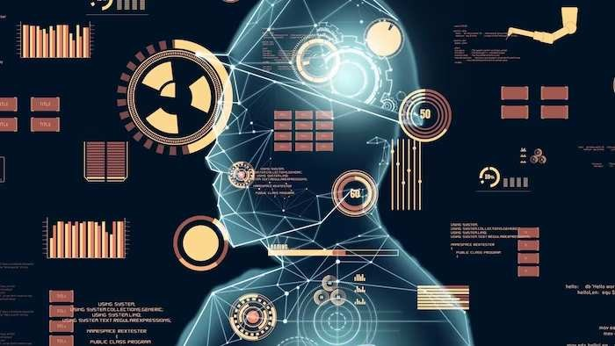
Future Research Directions
The authors want to improve adversarial attack methods to ﬁnd more statistical biases.
The authors also want to study regularization and data augmentation to reduce MRC model statistical biases.
The authors plan to provide their code and data so others may
replicate and expand their study.

Slide 11
CONCLUSION
The study "Using Adversarial Attacks to Reveal the Statistical Bias in Machine Reading Comprehension Models" discusses the frequency of statistical biases in MRC models and proposes a unique adversarial attack strategy to discover and mitigate them. The study shows that this strategy reduces statistical biases on model performance, making MRC systems more fair and resilient. The paper's contributions are a major step toward constructing impartial and trustworthy MRC systems, but real-world application and model explainability need more study.

Slide 12
Thank You!

